Slide 1
Lecture 11a Solving Recurrence Relations 4 The Master Method

Slide 2
Solving Recurrence Relations
2
Guess + Prove by Induction
Telescoping a Sum
Substituting
Solving homogeneous/inhomogeneous relations
Master Method
only the order obtained, not the precise formula (technically not solution)

Slide 3
The Master Method
Can be applied to recurrence relations of the following general form
T(n) = aT(n/b) + f (n) where f(n) ∈ Θ(nd), d ≥ 0
Master Theorem: If a < bd, T(n) ∈ Θ(nd)
If a = bd, T(n) ∈ Θ(nd log n)
If a > bd, T(n) ∈ Θ(nlog ^{b} a )
Notes:
3

Slide 4
The Master Method
T(n) = a*T(n/b) + f(n)
Often T(n) = a*T(n/b) + cn^{d}
Usually T(n) = a*T(⎣n/b⎦) + f(n), or
T(n) = a*T(⎡n/b⎤) + f(n)

Slide 5
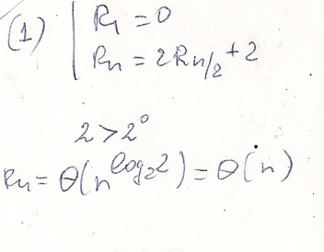
The Master Method: Examples
T(n) = aT(n/b) + f (n) where f(n) ∈ Θ(nd), d ≥ 0
Master Theorem: If a < bd, T(n) ∈ Θ(nd)
If a = bd, T(n) ∈ Θ(nd log n)
If a > bd, T(n) ∈ Θ(nlog ^{b} a )
5

Slide 6
Same example - telescoping

Slide 7
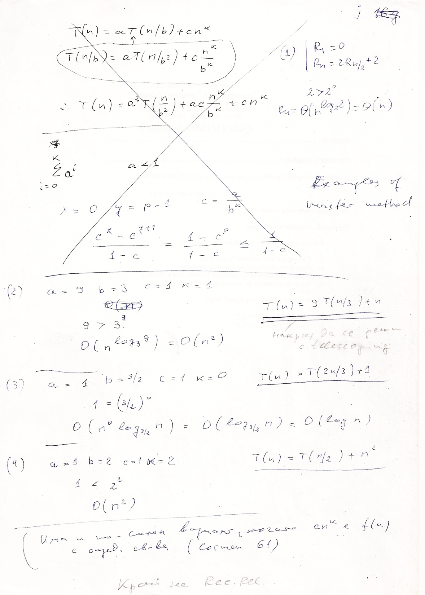


Slide 8
Solve using telescoping

Slide 9
Recall: The Master Method
Can be applied to recurrence relations of the following general form
T(n) = aT(n/b) + f (n) where f(n) ∈ Θ(nd), d ≥ 0
Master Theorem: If a < bd, T(n) ∈ Θ(nd)
If a = bd, T(n) ∈ Θ(nd log n)
If a > bd, T(n) ∈ Θ(nlog ^{b} a )
Notes:
9

Slide 10
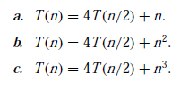

The Master Method: Examples
T(n) = 4T(n/2)+n+5
T(n) = 5T(n/4)+n-3
T(n) = 9T(n/3)+n²+4
T(n) = 6T(n/2)+n²-2
T(n) = 4T(n/2)+n³+7

Slide 11
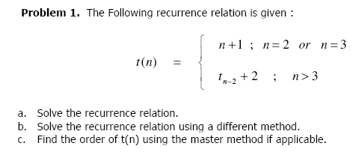
Example

Slide 12
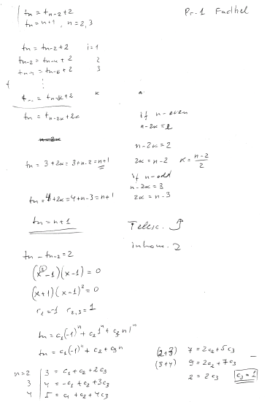
Telescoping

Slide 13
Inhomogeneous

Slide 15
Induction

Slide 16
Example
Problem 6 from midterm

Slide 17

Analysis for c_{n}
Telescoping
Analysis for count_{n}

